Slide 1
PHYS4260 Quantum Mechanics II Spring 2025
Scattering Theory

Slide 2
Outline
Rutherford formula
Quantum scattering
Partial wave formalism

Slide 3
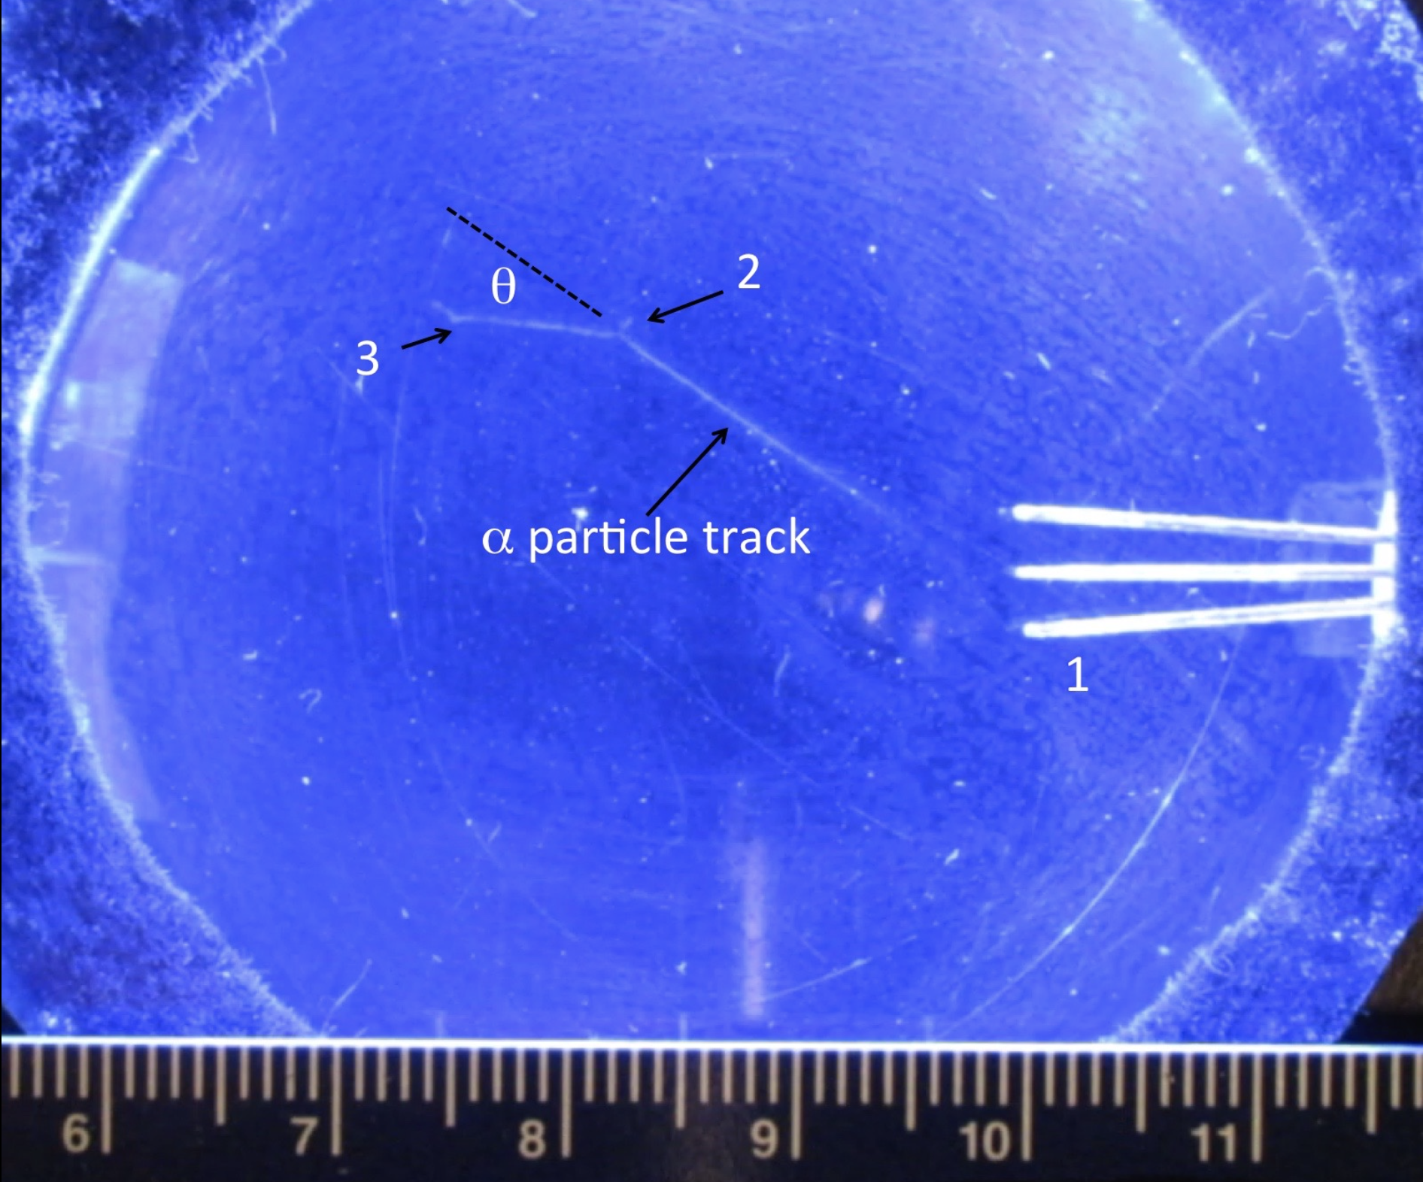
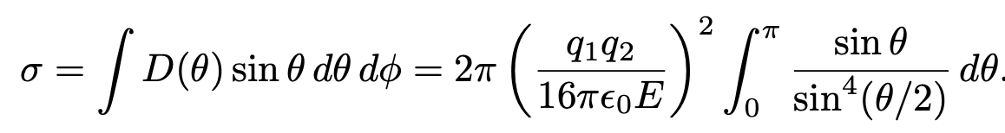
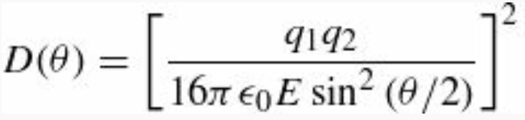
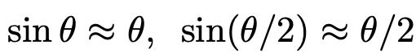
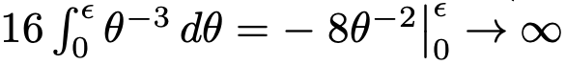
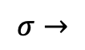
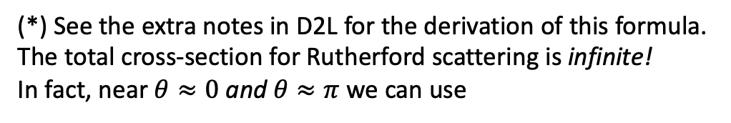
Re: Scattering theory - Rutherford formula
(*)
(*) See the extra notes in D2L for the derivation of this formula.
The total cross-section for Rutherford scattering is infinite!
In fact, near $θ≈0$ and $θ≈π$ we can use
Then
$$σ→$$
In a cloud chamber, a 5.3 MeV alpha particle track from a lead-210 pin source near point 1 undergoes Rutherford scattering near point 2, deflecting by an angle of about 30°. It scatters once again near point 3 and finally comes to rest in the gas. The target nucleus in the chamber gas could have been a nitrogen, oxygen, carbon, or hydrogen nucleus. It received enough kinetic energy in the elastic collision to cause a short visible recoiling track near point 2. (The scale is in centimeters.)

Slide 4
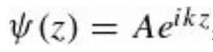
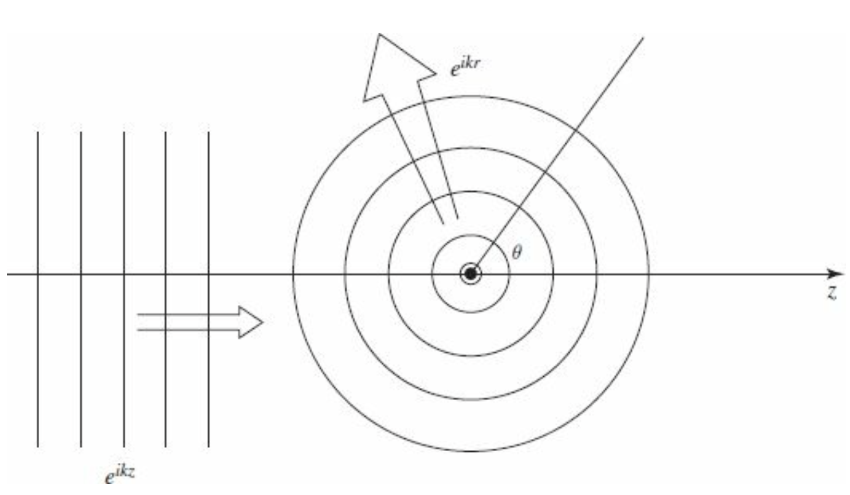
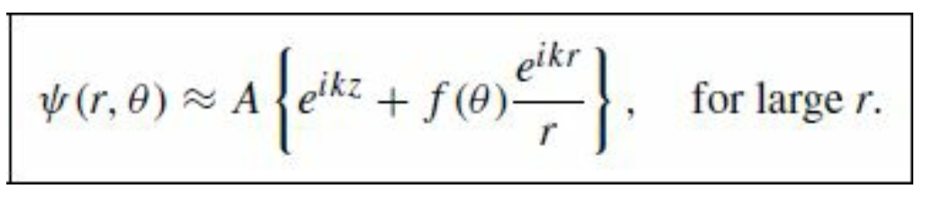
Quantum Scattering
In the quantum theory of scattering, we imagine an incident plane wave,
traveling in the z direction, which encounters a scattering potential, producing an outgoing spherical wave.
That is, we look for solutions to the Schrödinger equation of the generic form
For the moment, there’s not much quantum mechanics in this; what we’re really talking about is the scattering of waves, as opposed to particles, and you could even think of the Figure as a picture of water waves encountering a rock, or (better, since we’re interested in 3-dimensional scattering) sound waves bouncing off a basketball.

Slide 5
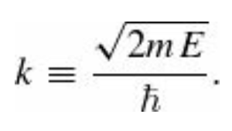
Quantum Scattering
The spherical wave carries a factor of $1/r$ because this portion of ${|ψ|}^{2}$ must go like $1/r^{2}$ to conserve probability. The wave number k is related to the energy of the incident particles in the usual way:
As before, we assume the target is azimuthally symmetrical;
in the more general case f would depend on φ as well as θ.

Slide 6
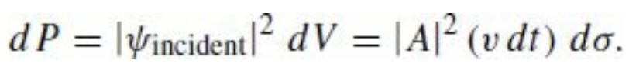
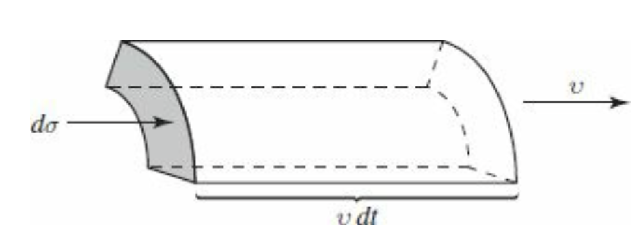
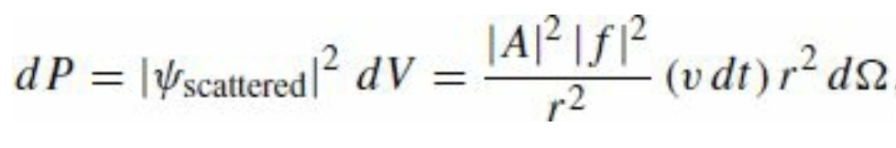
Quantum Scattering
The whole problem is to determine the scattering amplitude $f(θ)$; it tells us the probability of scattering in a given direction θ, and hence is related to the differential cross-section. Indeed, the probability that the incident particle, traveling at speed v, passes through the infinitesimal area $dσ$ in an infinitesimal interval of time dt, is
But this is equal to the probability that the particle scatters into the corresponding solid angle $dΩ$

Slide 7
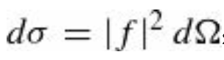
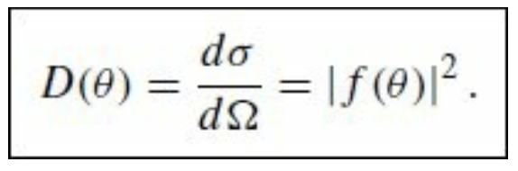
Quantum Scattering
From this, it follows that
and therefore
Evidently the differential cross-section (which is the quantity of interest to the experimentalist) is equal to the absolute square of the scattering amplitude (which is obtained by solving the Schrödinger equation).
In what follows, we will study two techniques for calculating the scattering amplitude: partial wave analysis and the Born approximation.

Slide 8
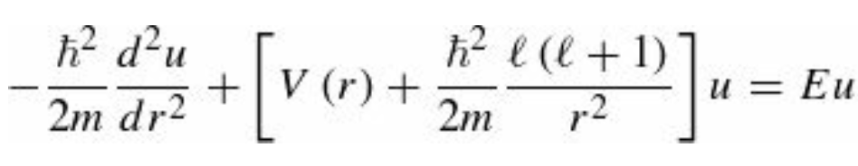
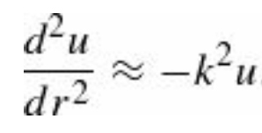
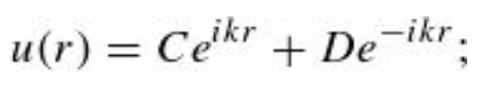
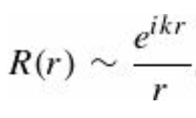
Partial wave analysis formalism
We learned that the Schrödinger equation for a spherically symmetrical potential $V(r)$ has solutions that are factorized in their variables
where $Y_{l}^{m}(θ,φ)$is a spherical harmonic, and $u(r) = r R\left(r\right)$ satisfies the radial equation
At very large r the potential goes to zero, and the centrifugal contribution is negligible, therefore we can write
which admits as a general solution
the first term represents an outgoing spherical wave, and the second an incoming one—for the scattered wave we want
$D = 0$. At very large r, then,

Slide 9
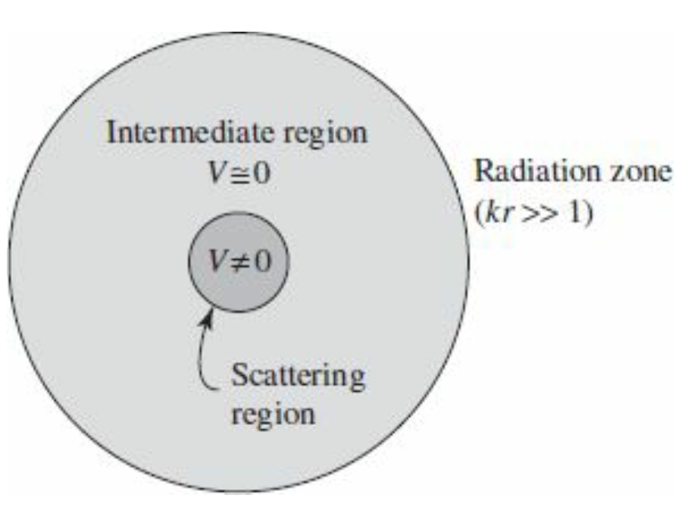
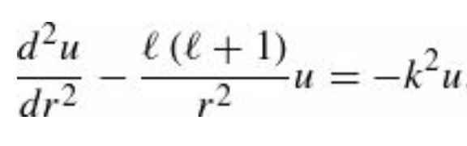
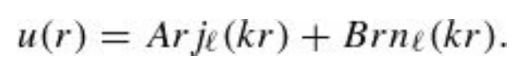
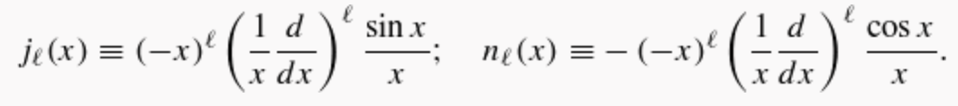
Partial wave analysis formalism
That’s for very large r (more precisely, for $kr>>1$ ; in optics it would be called the radiation zone). As in one-dimensional scattering theory, we assume that the potential is “localized,” in the sense that exterior to some finite scattering region it is essentially zero (see Figure).
In the intermediate region (where V can be ignored but the centrifugal term cannot), the radial equation becomes
and the general solution (See Ch 4, Equation 4.45) is a linear combination of spherical Bessel functions:

Slide 10
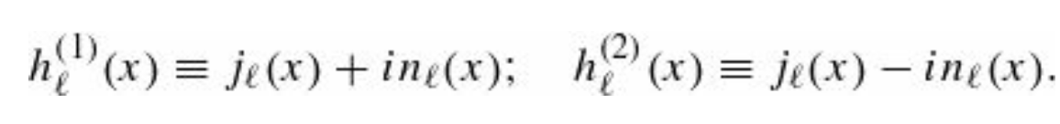
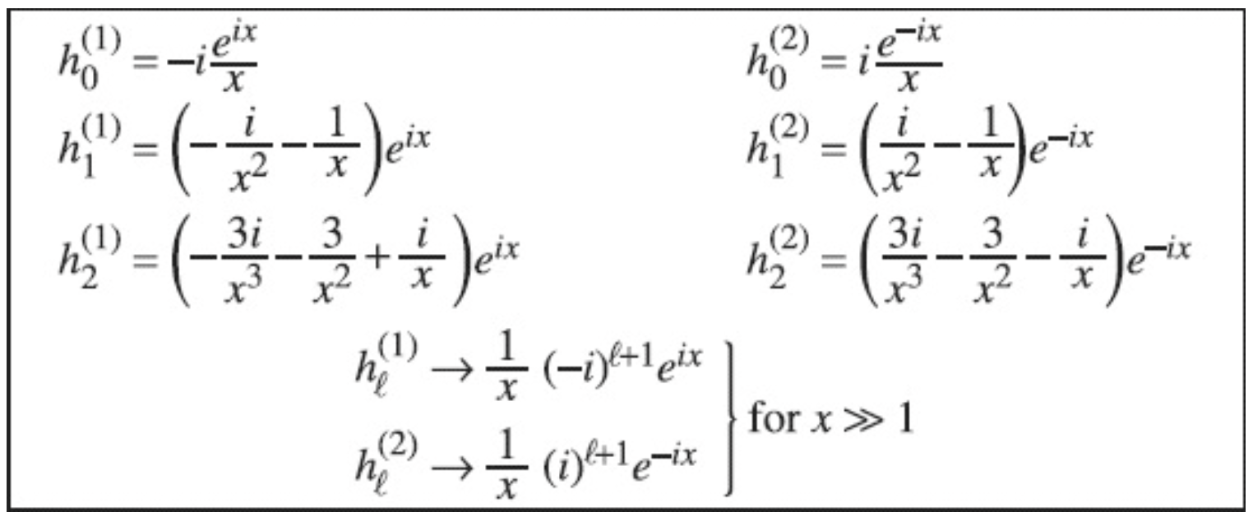
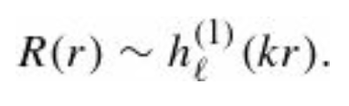
Partial wave analysis formalism
However, neither $j_{l}$ (which is somewhat like a sine function) nor $n_{l}$ (which is a sort of generalized cosine function) represents an outgoing (or an incoming) wave. What we need are the linear combinations analogous to $e^{−ikr}$ and $e^{ikr}$.
These are known as spherical Hankel functions:
The first few Henkel functions are listed in the table here below
At large r, $h_{l}^{\left(1\right)}(kr)$ (the Hankel function of the first kind) goes like $e^{ikr}/r$, whereas $h_{l}^{\left(2\right)}(kr)$ (the Hankel function of the second kind) goes like $e^{−ikr}/r$.
for outgoing waves, then, we need spherical Hankel functions of the first kind:

Slide 11
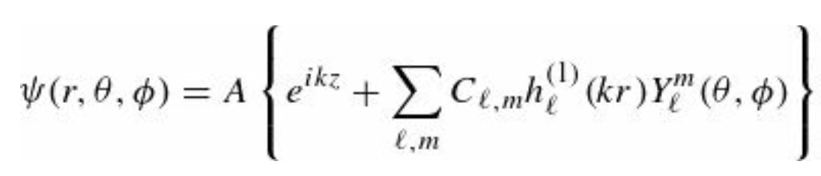
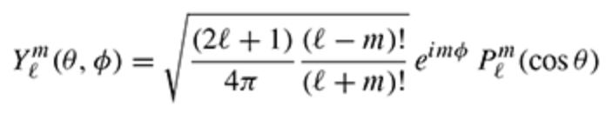
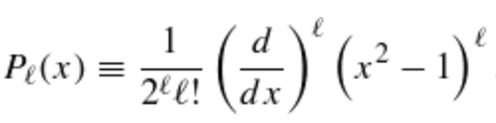
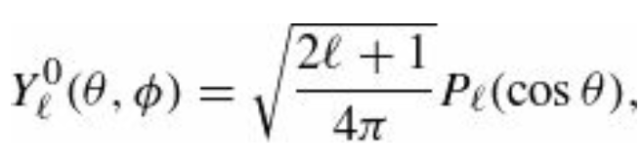
Partial wave analysis formalism
The exact wave function, in the exterior region (where $V(r)=0$) is
The first term is the incident plane wave, and the sum (with expansion coefficients $C_{l,m}$) is the scattered wave. But since we are assuming the potential is spherically symmetric, the wave function cannot depend on $φ$.
So only terms with $m=0$ survive (remember that $Y_{l}^{m}\sim e^{−imφ}$). From previous results, we have obtained that the spherical harmonics are
where $P_{l}^{m}(\cos{θ})$ are the Legendre polynomials as
Therefore, $m=0$for we can write the solely survivor term

Slide 12
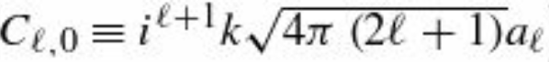
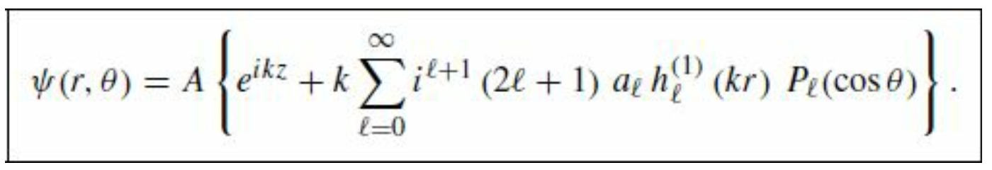
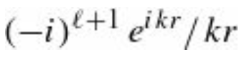
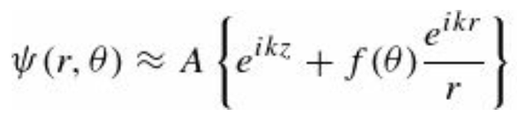
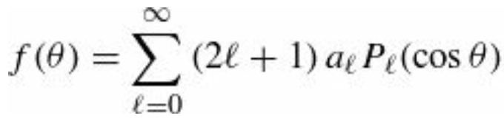
Partial wave analysis formalism
At this point, it is customary to redefine the expansion coefficients as
We shall see in a moment why this peculiar notation is convenient.
$a_{l}$ is the $l$-th partial wave amplitude.
For very large r, the Hankel function goes like (see the Table we have shown before). Therefore
where

Slide 13
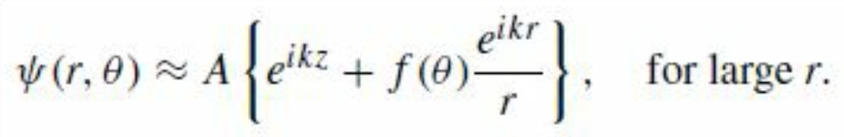
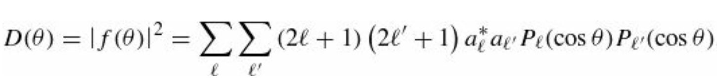
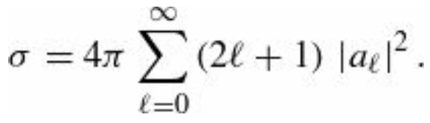
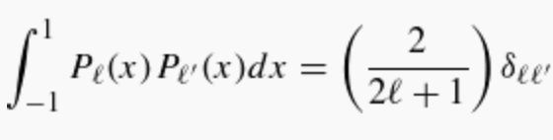
Partial wave analysis formalism
At the beginning of our discussion of quantum scattering theory we postulated the solution in the large-$r$ region
What we have found, confirms more rigorously this general (postulated) structure and tells us how to compute the
scattering amplitude $f(θ)$ in terms of the partial wave amplitudes $a_{l}$. The differential cross- section is
and the total cross-section is*
*The orthogonality of the Legendre polynomials
has been used to do the angular integration in
the cross-section calculation.

Slide 14
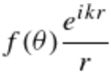
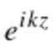
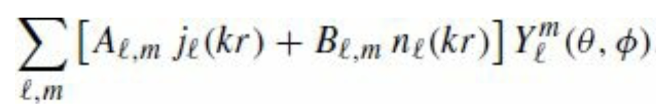
Partial wave analysis formalism
Determination of the partial wave amplitudes $a_{l}$ for $V(r)$
All that remains is to determine the partial wave amplitudes, $a_{l}$ for the potential in question. This is accomplished by
solving the Schrödinger equation in the interior region (where $V(r)$ is not zero) and matching it to the exterior solution,
using the appropriate boundary conditions. The only problem is that as it stands our notation is hybrid:
We used spherical coordinates for the scattered wave:
but cartesian coordinates for the incident wave:
We need to rewrite the wave function in a more consistent notation. We observe that
$e^{ikz}$ definitely satisfies the Schrödinger equation with $V\left(r\right)=0$
We just argued that the general solution to the Schrödinger equation with $V\left(r\right)=0$ can be written as
Therefore, it must be possible to express $e^{ikz}$ in the same way.

Slide 15
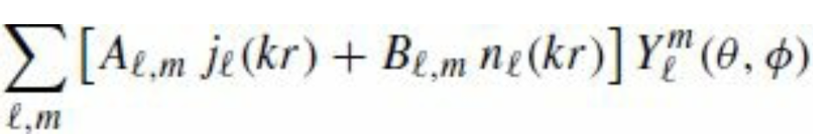
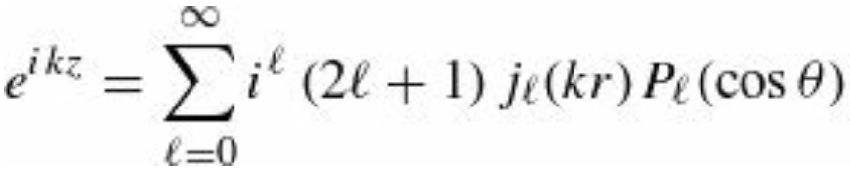
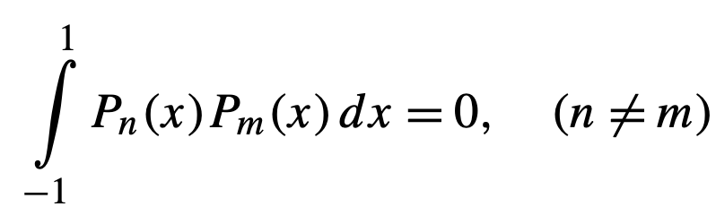
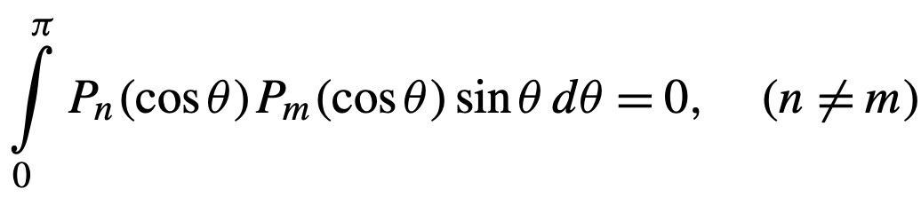
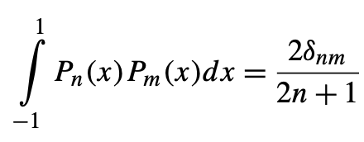
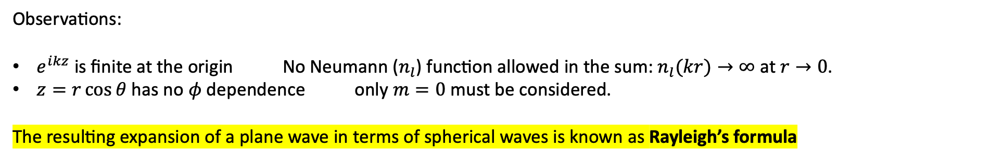
Partial wave analysis formalism
Observations:
$e^{ikz}$ is finite at the origin No Neumann ($n_{l}$) function allowed in the sum:$n_{l}(kr)→∞$ at $r→0$.
$z=r\cos{θ}$ has no $φ$ dependence only $m=0$ must be considered.
The resulting expansion of a plane wave in terms of spherical waves is known as Rayleigh’s formula
To prove this relation, we need to use the orthogonality condition of Legendre polynomials
In general, one has that

Slide 16
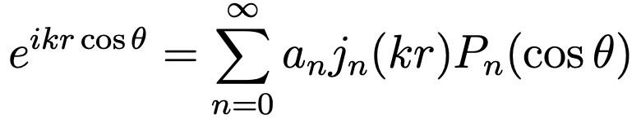




Proof of the Rayleigh’s formula
where $j_{n}(kr)$ is the spherical Bessel function of order $n.$
To prove this relation, we multiply LHS and RHS by and we integrate over $θ$
(1)
Using the orthonormality of Legendre polynomials, RHS of equation (1) reduces to
Since we are interested in the limit $kr → 0$, we Taylor expand the spherical Bessel function (see extra notes in D2L)

Slide 17





Proof of the Rayleigh’s formula
To eliminate the $r$ dependence, we differentiate Eq. (1) with respect to $(kr) l$ times and we take the limit $(kr)→0$. These steps for the spherical Bessel part on the RHS of Eq. (1) give
On the LHS of Eq. (1) we implement the same procedure and obtain
$$=$$
where for the last integral we used the following result
$$n$$
This leads to our result

Slide 18







Partial wave analysis formalism
Using this, the wave function in the exterior region can be expressed entirely in terms of r and θ:
Example: Quantum hard-sphere scattering.
Let’s assume the following potential
The boundary condition on the wave function is . That is
for all θ. Applying orthogonality to the previous equation, we find that

Slide 19




Example: Quantum hard-sphere scattering cont’d
At this point, we can calculate the exact cross section
That’s the exact answer, but it’s not terribly illuminating, so let’s consider the limiting case of low- energy scattering: $ka<<1$. Since $k=2π/λ$ this amounts to saying that the wavelength is much greater than the radius of the sphere.)
Looking at the Tab for the first few Bessel functions we note that $n_{l}\left(x\right)≫j_{l}\left(x\right)$ for small $x$. Therefore,
and hence

Slide 20


Example: Quantum hard-sphere scattering cont’d
But we’re assuming $ka<<1$ so the higher powers are negligible—in the low-energy approximation the scattering is dominated by the $l=0$ term. (This means that the differential cross-section is independent of θ, just as it was in the classical case.) Evidently
for low energy hard-sphere scattering.
Surprisingly, the scattering cross-section is four times the geometrical cross-section—in fact, σ is the total surface area of the sphere.
This “larger effective size” is characteristic of long-wavelength scattering (it would be true in optics, as well); in a sense, these waves “feel” their way around the whole sphere, whereas classical particles only see the head-on cross-section

